Slide 1
CCA – Machine Learning c 17th Oct 2016

Slide 2
Preprocessing
Build & maintain corpora for abbreviations and spelling corrections
Feature Extraction
Bag Of Words features to capture syntactic aspect of descriptions
Word2Vec features to capture semantic aspect of descriptions
Machine Learning
8 diverse classifiers are used as weak learners
Metamap used as a third party lookup for normalizing medical abbreviations
Feature Cleaning
Remove Zero Variance features that have less than 0.03 (configurable) standard deviation
Calculate pair-wise collinearity removing perfectly collinear features, one from each pair having Pearson correlation coefficient >= 1.0 (configurable)
Stacking ensemble technique is used. Random Forest is used as combiner algorithm to make a final prediction along with a confidence score
Feature Importance
Ranked feature importance is extracted from the trained Random Forest model.
4 Important features are then extracted per description based on the ranked features

Slide 3
Feature Extraction
Initially 140 features from Metamap was used. However it was failing to capture finer variations in the training descriptions. E.g. distinguishing between painkillers and antibiotics. Since Metamap could not be customized, it was dropped.
Bag Of Words (BOW) model was introduced since it was found that the (frequency of) occurrence of words could be used as features taking care of the syntactic meaning of descriptions. This would later on also help in identifying 4 important features per description
The BOW features result in a huge sparse matrix e.g. 15k descriptions result in 15000 X 7596 sparse matrix
Replacing Metamap, Word2vec model was trained on a large corpus crawled from Wikipedia. 149 features were carefully selected, some from Metamap and some others that would capture the semantic meaning of the descriptions.
Currently the BOW and Word2Vec features transforms the unstructured descriptions into vectors for Machine learning

Slide 4
Feature Cleaning
15K descriptions results in a 15000 X 7596 feature matrix. Though sparse it needs to be cleaned of zero variance, collinearity etc.…
Principal Component Analysis (PCA) was tried out for dimension reduction. However it clubs up the individual features into components. This would make extraction of important features per description difficult. Refer to the slide Feature Importance for further details.
Hence standard deviations for each feature is calculated using the built-in function from pandas and features having the standard deviation <= 0.03 (configurable) were dropped.
Again pair-wise collinearity was computed. One of a pair having Pearson correlation coefficient >= 1.0 (configurable) was dropped.
The feature cleaning is a time taking step and needs to be optimized.

Slide 5
Machine Learning : Ensemble & Algorithms
Ensemble methods use multiple learning algorithms to obtain better predictive performance than could be obtained from any of the constituent learning algorithms alone.
Empirically, ensembles tend to yield better results when there is a significant diversity among the models. The goal was thus to have large number of diverse, weak, heterogeneous learners to have a stronger ensemble.
Hence 8 diverse algorithms - Support Vector Classifier, Multinomial Naïve Bayes Classifier, One Vs Rest Logistic Regression Classifier, Random Forest Classifier, Deep Neural Network Classifier, K Nearest Neighbors Classifier, Linear Discriminant Analysis Classifier & Extreme Gradient Boosting Classifier were selected. Minimal parameter tuning was performed for each algorithm to keep each learner weak
Most popular ensemble combination schemes are Boosting, Bagging and Stacking
We chose Stacking over simple voting because of the additional accuracy gains by Stacking – [3]

Slide 6
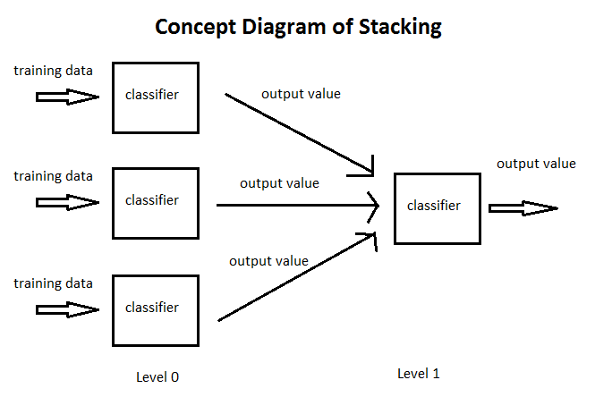
Machine Learning : Ensemble by Stacking
Stacked generalization is a means of non-linearly combining generalizers to make a new generalizer, to try to optimally integrate what each of the original generalizers has to say about the learning set. The more each generalizer has to say (which isn’t duplicated in what the other generalizer’s have to say), the better the resultant stacked generalization. Wolpert (1992) Stacked Generalization….[2]

Slide 7
Machine Learning : Ensemble by Stacking (contd.)
Why did we use random forest for ensembling, why not just simple voting method? etc.
A total of 3 classifiers were chosen – Random Forest, One Vs Rest Logistic Regression & Decision Tree for the level 2 ensemble
5-fold stratified cross validation was performed to determine the best classifier out of 3 for ensemble
Random Forest gave best performance for ensemble
Each of the 8 classifiers gave a classified charge class. The 8 classifications were given as inputs to the ensemble and voted output was predicted.
8 Correct (Binary– 0/1) columns were added that denoted whether the predicted and voted charge class were same.
Confidence Score = ∑ (Probability x Correct)/No. of classifiers

Slide 8
Feature Importance
DUAL INF PUMP-SIGNATURE GOLD
pump
infusion
dual
signature
4 important features were also required per description along with the charge class and confidence score
The Bag Of Words model uses (frequency of) occurrence of words as features.
The Random Forest classifier once trained, also gives the ranked list of important features.
Every description was tokenized. Each token was matched with the list of important features. First four matches were considered and returned as the important features for that description.

Slide 9
References
Medical Concepts (attached)
Wolpert, D.H.: Stacked generalization. Neural Networks 5(2) (1992) 241–260
Sill, Joseph; Takacs, Gabor; Mackey, Lester; Lin, David: Feature-Weighted Linear Stacking

Slide 10
Thank You

